Slide 1
Data Use Summary
August 2023
Survey results and Interviews 19 January 2023 – 23 July 2023
N = 14 Survey Link
Funding was through a sub-award of USDA AFRI Grant 2021-77039-35992

Slide 2
Outline
Demographics
Perceptions
Data Collection & Storage
Data Access & Transfer

Slide 3
Survey Respondent Demographics

Slide 4
Comfort and Knowledge Using Technology

Slide 5
Factors Influencing Data Sharing

Slide 6
Equipment Capabilities and Usage

Slide 7
Equipment Data Transfer Methods
*CAN = 3rd party CAN logging device

Slide 8
Other Technologies & Data Collected

Slide 9
Data Access

Slide 10
Data Archival, Repository
Would you be interested in an independent service that stores your approved/validated grower/farm/field structure with field boundaries and names you could share with other service providers for more consistent and accurately labeled work records?

Slide 11
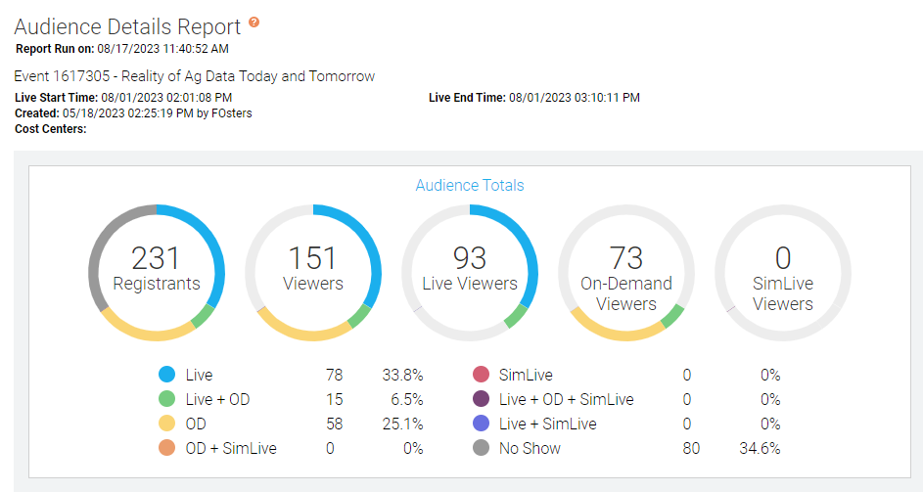
Webinar Poll Responses
Poll responses from live webinar conducted 1 August 2023
On Demand recording here: https://event.webcasts.com/starthere.jsp?ei=1617305&tp_key=cd7c23f7d6

Slide 12
Live Webinar Poll Responses

Slide 13
Interview Summaries & Key Insights

Slide 14
University Extension/Research Interview Findings
Key Insights & System Requirements: University 1
Having a tool that can automate data collection from participating growers, reading disparate data in from cooperating farmers into a centralized common format would be beneficial.
Having some sort of tool that could collect data based on each study from the field may be helpful. Much of the data hand entered into the spread sheet are things like stand counts and other info captured in the field.
Key Insights & System Requirements: University 2
Onboarding needs to be very easy and simple to set up and link accounts since they have quite a few new participants each year.
Having some sort of versioning or change log like GitHub to know when a file was last changed or updated and by whom would be beneficial.

Slide 15
Input & Service Provider Interview Findings
Key Insights & System Requirements: Service Provider
Need to have an integration with the ERP/FMIS of choice for the retailer
Commercial FMIS tools seem to be doing a good job of making public information accessible
Most growers still not real engaged in data management
Livestock, manure management an area that is likely to see more technology in the next few years
Carbon/GHG programs are on the verge of becoming more common place, growers will need to be able to provide 3-5 years of field level information
Key Insights & System Requirements: Retailer and Service Provider
Not many growers engaged in managing their own data, most do not even appear to be interested
Retailers collect a lot of data on behalf of the grower and use a variety of tools to provide services to the grower
Participation in GHG/Carbon programs is difficult and time consuming currently with limited support for precision agriculture data types/file formats
Retailer ERP/FMIS using API’s to pull a lot of data, provide access to public data sources
Growing need to also pull in data from soil sensors, irrigation systems, not just tradition equipment clouds

Slide 16
Fairly Progressive Grower Interview Findings
Key Insights & System Requirements: Grower
Need a place to reliably/securely back up data in case a service provider goes away or if they change as it is difficult to get data back out of systems
This storage location needs to enable management of the data on the grower’s behalf by their service provider(s)
Still a lot of data collection and analysis is manual in spreadsheets, off paper records
Growers are able to collect a lot of data but knowing what to do with it or how to derive value is a challenge

