Slide 1
Industry defined standards solving digital interoperability
Ben Craker
AgGateway Portfolio Manager
23 October 2023

Slide 2
Agenda
AgGateway Overview
Project and Digital Resource Overview
  Agricultural Data Application Programing Toolkit (ADAPT)
  Modus Agricultural Lab Test Data Standardization
  Precision Agriculture Irrigation Language (PAIL, ASABE S632, ISO7673)
  Field Boundaries
Questions & Discussion

Slide 3
AgGateway Overview
https://www.aggateway.org/EventsandEducation/AboutAgGateway.aspx

Slide 4
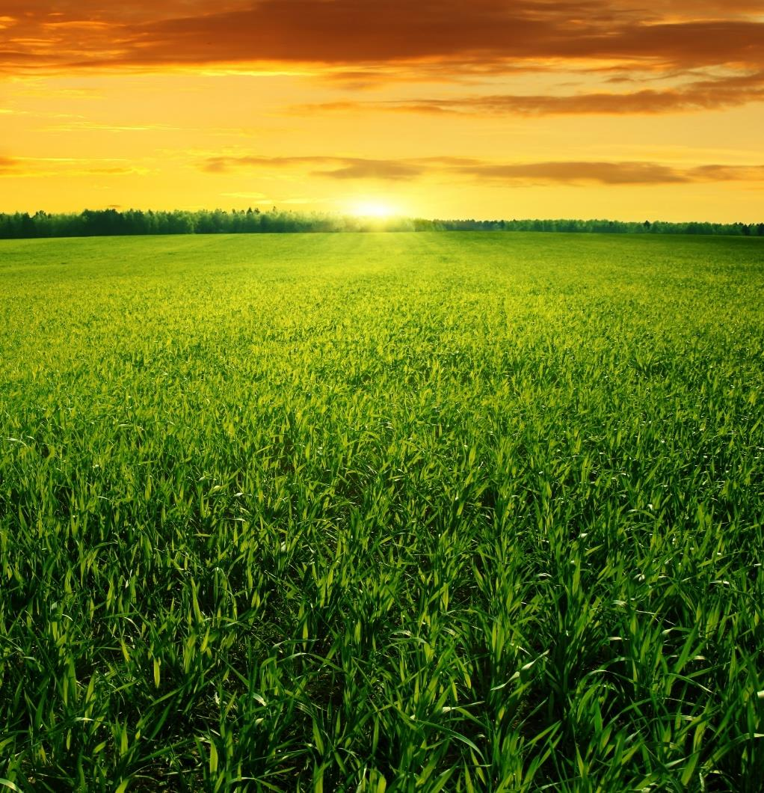
AgGateway:
A non-profit
member association leading the global transition to digital agriculture.
Notes:
We’re a global, non-profit organization that helps agri-businesses expand their ability to exchange and use information.
Agricultural companies today need to be able to access data that is timely, relevant, accurate and complete. To do that, they need standards and other connectivity resources, so that companies and systems can share information.

Slide 5
Our Mission:
To develop
the resources and relationships that drive digital connectivity
in global agriculture and related industries.
Notes:
We’re a global, non-profit organization that helps agri-businesses expand their ability to exchange and use information.
Agricultural companies today need to be able to access data that is timely, relevant, accurate and complete. To do that, they need standards and other connectivity resources, so that companies and systems can share information.

Slide 6
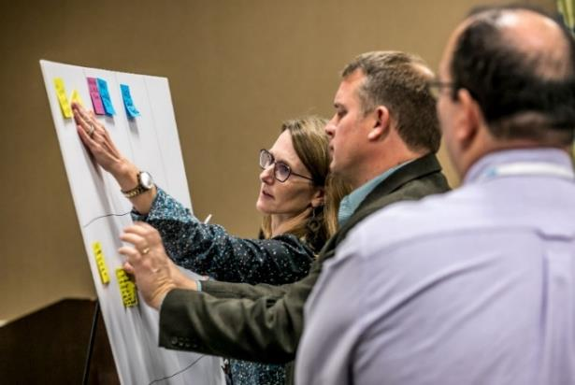

AgGateway teams work to enable:
  More transparent and efficient supply chain processes
  Seamless exchange of data between different systems
  Ability to leverage data to increase profitability and sustainability.
Notes:
Our member companies collaborate to identify pain points and develop solutions so that digital connections are possible – whether it’s for an order-to-invoice process, barcoding and traceability, or making sure a farmer’s hardware and software systems can seamlessly connect and “talk” to each other.
We develop and implement the common industry standards that make these things possible.

Slide 7







































Some of our members…
Notes:
Here are some of our 200 member companies. As you can see, we have broad representation across the industry. Our members include Ag Retailers; Manufacturers of seed, crop nutrition, crop protection and equipment; Distributors, Grain & feed companies, Precision ag providers, Specialty chemical manufacturers; Software and data service providers; and a few growers.

Slide 8


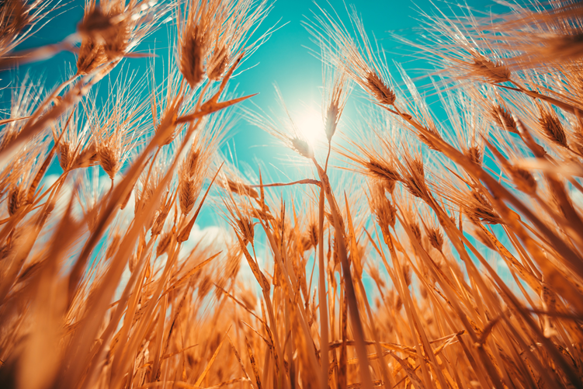




Collaboration for industry-wide, global solutions
…standards groups, govt agencies, trade associations…
Notes:
AgGateway teams do not work in a void. We’re in conversation and work with standards groups, trade associations and government agencies. I put the names of just a few of those groups up on this slide – there are many more.
The reason: Whatever solutions a team develops has to be compatible and workable throughout the industry and globally.
There’s no point in re-inventing the wheel. We like to find what’s already been developed and make sure we adopt those standards or guidelines in the work we’re doing.

Slide 9
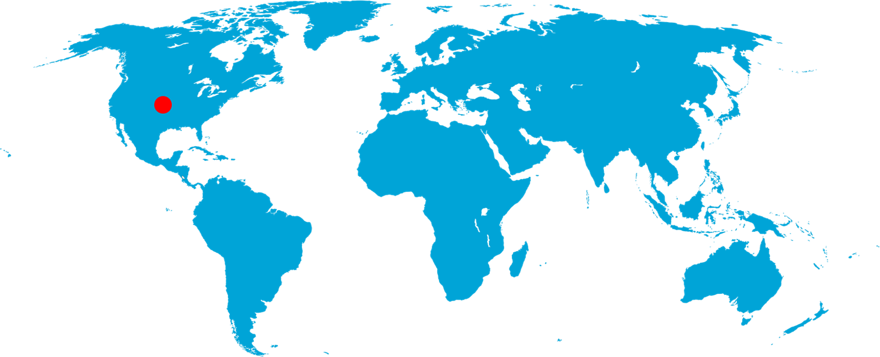
AgGateway Around the Globe
Notes:
We’re a global organization focused on global standards. We have regional groups in North America, Europe and Latin America. And we also have interest in Asia and Australia/New Zealand.

Slide 10
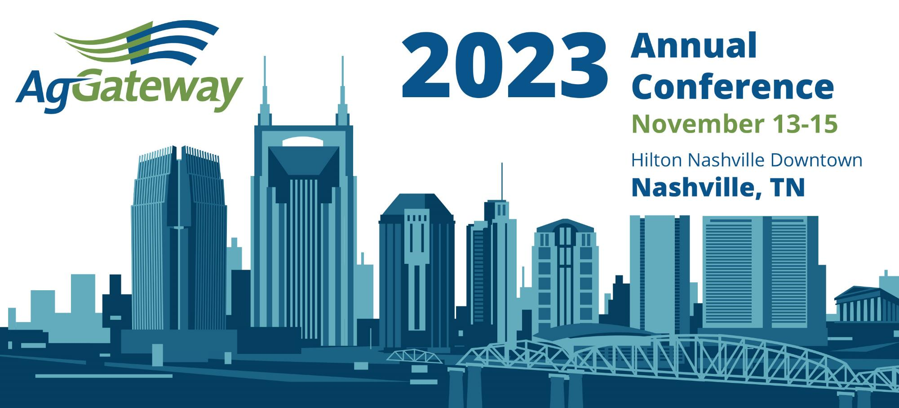

Slide 11
AgGateway Digital Resource Development
Advisory Groups
Strategic in nature, providing longer term guidance in a subject area
Working Groups
Shorter in duration, delivering defined digital resources
Member organizations affirmatively join a Working Groups via Join Form
Organizational participation must be confirmed by AgGateway primary contact per IP policy
User Stories
Use Cases
Data Buckets
Develop/ Gap Check
Publish

Slide 12




Active & Completed Working Groups
WG22
WG05
WG06
WG12
WG15
WG18
WG01
WG20
WG19
WG04
WG09
WG14
WG03
WG16
WG08
WG00
WG07
WG13
WG17
WG11
WG21
Input manufacturer
Input distribution/retail
Farm
Field operations
Processor
WG00 Agrisemantic Infrastructure PoC
WG01 In-Field Product ID Seeding Pilot
WG03 Product Catalog
WG04 Ag Lab Data (Modus)
WG05 Mix Ticket (dispensing Work Order/Record)
WG06 Farm Inputs: Reference Data
WG07 Farm Inputs: Work Order, Work Record
WG08 In-Field Product ID ADAPT Plugin
WG09 Linked Data (DatasetMetadata)
WG11 LATAM Soil Data
WG12 PAIL
WG13 Closed Loop Spray
WG14 Potato Provenance
WG15 Scale Ticket
WG16 Crop Protection Product Guidelines
WG17 Field Boundaries: Terms & Definitions
WG18 Crop Nutrition 3rd Party Product Management
WG19 ADAPT Serialization
WG20 Traceability API
WG21 European Reporting ADAPT Mapping
WG22 Booking & Prepay Reporting
WG24 Field Boundary: GNSS Accuracy

Slide 13
ADAPT: Agricultural Data Application Programming Toolkit
ADAPT: Interoperability through an industry open-source toolkit
ASABE Paper #2462264

Slide 14
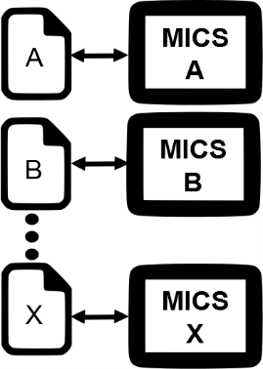
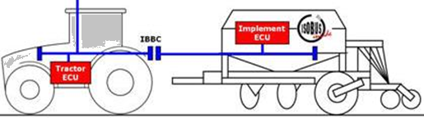

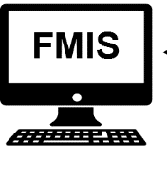

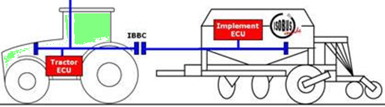
Grower/FMIS Perspective Without ADAPT
Cooperative Operation – Send Work Orders
Different formats/contents
Existing ISO TC Standards
On/Off & Variable-Rate Control
A
B

Slide 15

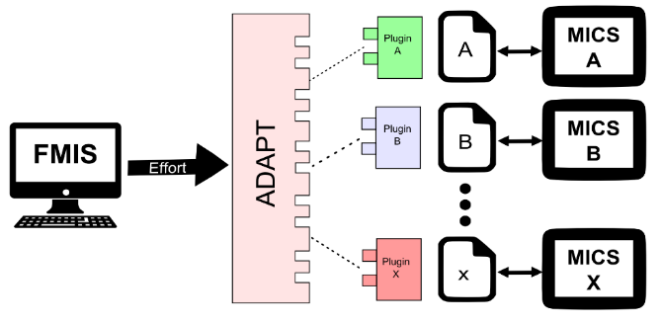
Grower/FMIS Perspective With ADAPT
Cooperative Operation – Send Work Orders
Reduced FMIS effort (user/developer)
Increased robustness / capabilities
Data Model with Common Contents
Existing ISO TC Standards
On/Off & Variable-Rate Control
A
B

Slide 16
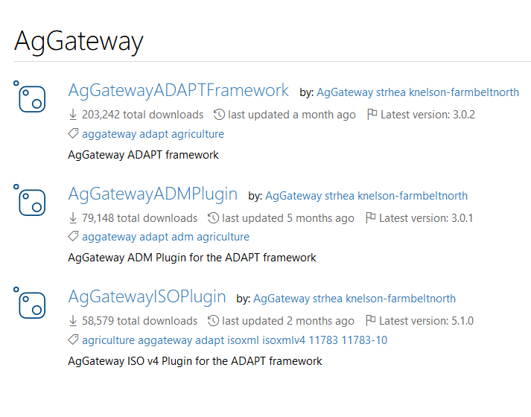
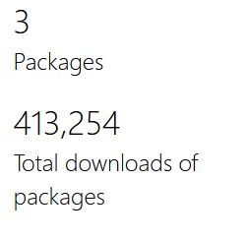
Over a 400,000 downloads!

Slide 17
What ADAPT is and is not today
ADAPT is
ADAPT is not
Open source
Microsoft .NET-based
Interoperability toolkit
Complimentary to AgIN
Supportive of ISOXML
Constantly improving
A standard (soon though)
A transport/routing protocol
A data-permissions framework
An API
A competitor to ISOXML
Perfect

Slide 18
ADAPT past, present, and future
2014
2022-05
2022-11
2023+
//
//
Begin ADAPT framework and plugin development
Begin ADAPT Standard development
Kick off ADAPT Serialization WG
Release ADAPT Standard v1
Publish ADAPT Serialization specification
Other*
*Other
ADAPT Standard development and maintenance
ADAPT Framework and plugin development and maintenance
Explore seamless interoperability among ADAPT Data Model, ADAPT Plugins, and ADAPT Standard
Consider process for ADAPT Standard → ISO Standard

Slide 19
AgGateway’s approach to developing the ADAPT Standard
Completely open activity. AgGateway membership is not required.
Using a GitHub project for issue management.
Using a cutting-edge tool for model development: Score
  Developed by AgGateway member NIST and AgGateway partner OAGi
  Enables creating ISO 15000-5-compliant information models and message profiles in defined business contexts
  Enables model expression in multiple syntaxes (currently OAS v3, JSON Schema, and XML Schema; future XMI, RDF, OWL as required)
  Browser-based and multi-user
  Supports versioning, model element state management

Slide 20
ADAPT Standard Principles
The purpose of the ADAPT Standard is to facilitate data transfer between systems.
The ADAPT Standard is a data representation for agricultural information centered on the field/production space.
It presumes that the data producer has sufficient interest in the consumer being able to correctly interpret the data to put forward the effort to accurately transform data into the model.
The ADAPT Standard seeks to avoid the data consumer needing to handle conditionality for multiple data producers.
The ADAPT Standard is an open format and not platform dependent.
The ADAPT Standard will allow serialization of subsets of the data model.
All data authorization, encryption, etc. is external to the standard itself.

Slide 21
ADAPT Resources
Resource | Location
ADAPT Homepage | https://AdaptFramework.org
ADAPT Framework Repo | https://github.com/ADAPT/ADAPT
ADAPT ISO Plugin Repo | https://github.com/ADAPT/ISOv4Plugin
ADM (ADAPT Data Model) Plugin Repo | https://github.com/ADAPT/ADMPlugin
ADAPT Visualizer Repo | https://github.com/ADAPT/ADAPT-Visualizer
ADAPT Standard Issue Board | https://github.com/ADAPT/Standard/projects/1
ADAPT NuGet Packages | https://www.nuget.org/profiles/AgGateway

Slide 22
Ag Lab Data Standardization (Modus)
https://ModusStandard.org

Slide 23
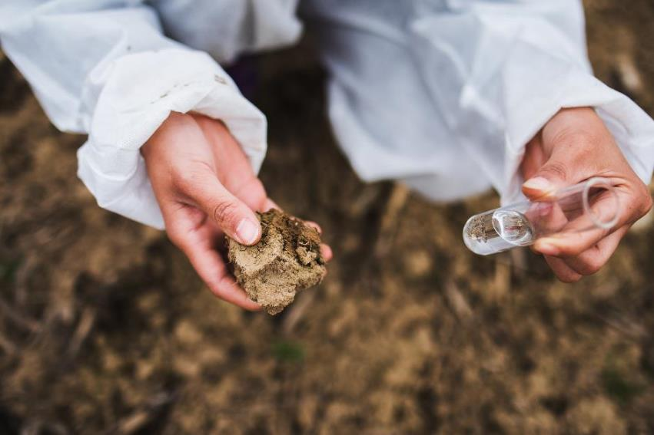
Why Soil Testing?
Most common data layer used by farm management information systems (FMIS) and other ag software
Sustainability, traceability, carbon and soil-health focused efforts will likely make soil testing mandatory
Currently only limited adoption of variable-rate technology (VRT) applications based on a soil test
We cannot afford the error associated with using “the wrong equation”
Not attempting to standardize test methods, just data generated

Slide 24
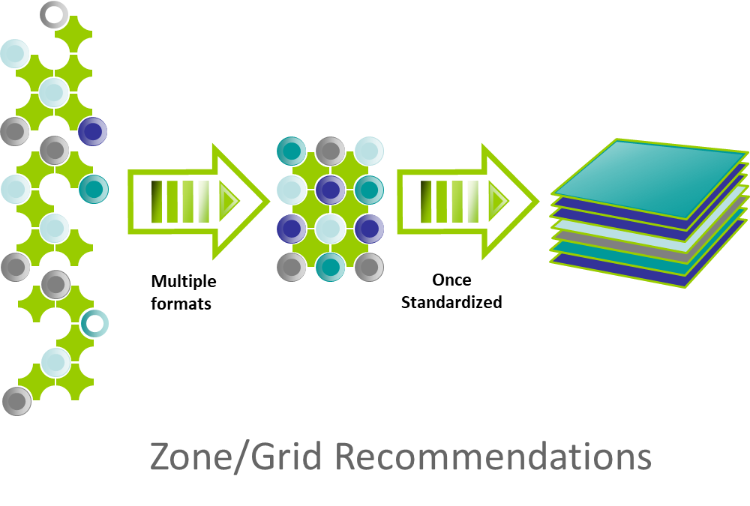
Laboratories are faced with using more than 70 data formats

Slide 25
Modus Agronomic Lab Testing Standard
Modus Timeline
  2013, 2014 discussion, meetings, and initial work
  2016: Dave Nerpel, Jason Ellsworth, Aaron Hunt (2016). Modus: A Standard for Big Data, a paper from the Proceedings of the 13th International Conference on Precision Agriculture July 31 – August 4, 2016. St. Louis, Missouri, USA
State in 2018:
  Most adopted format within the lab industry
  Strong for its Controlled Vocabulary
  XML format
  Existing Schema: Soil, Plant, Water, Manure, Nematodes
Needed to:
  Become a true “Open Source” product with a clear license
  Set up a process for future maintenance and progress
  Evolve to other serialization formats like JSON
  Clean up the vocabularies, create version 2, engage the certification organizations
Moved to
AgGateway
2020

Slide 26

Two AgGateway Working Groups
WG04 Lab Test Data
  Key Deliverables:
    Modus as Open-Source Standard
    Controlled Vocabularies
      (with Agrisemantics subcommittee)
    Updated schema XML, JSON
WG11 Integração Dados Laboratório Solos
  Key Deliverables:
    Documentation of specific requirements for a soil testing data standard in Brazil
    Regionally customized version of the WG04 BPMN
    Customization of the Modus standard for tropical soil analysis
    Survey of labs to identify current methods and datasets
This Photo by Unknown Author is licensed under CC BY

Slide 27
What’s New in v2.0?
v2.0 has approximately 820 different soil test methods, last Modus 1.0 revision has approximately 600 soil methods - Why?
  Added additional methods, several from Soil Health collaboration
  Applied the ISO19156 principles for observing and measuring to report results unambiguously
    More precise in describing test methods
      Some v1.0 methods map to more than one v2.0 method
    Additional information about each test method broken out
    Added the citation for a test method where possible

Slide 28

What’s New in v2.0?
UoM 1-8

Slide 29
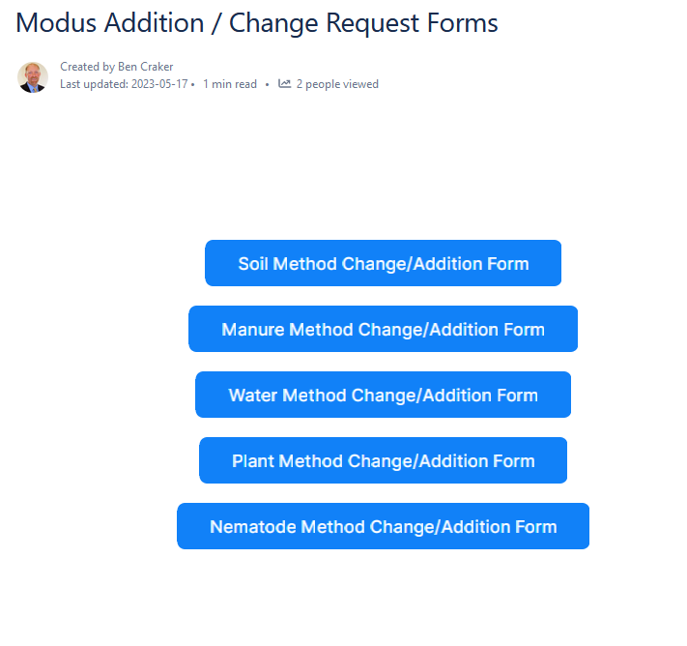
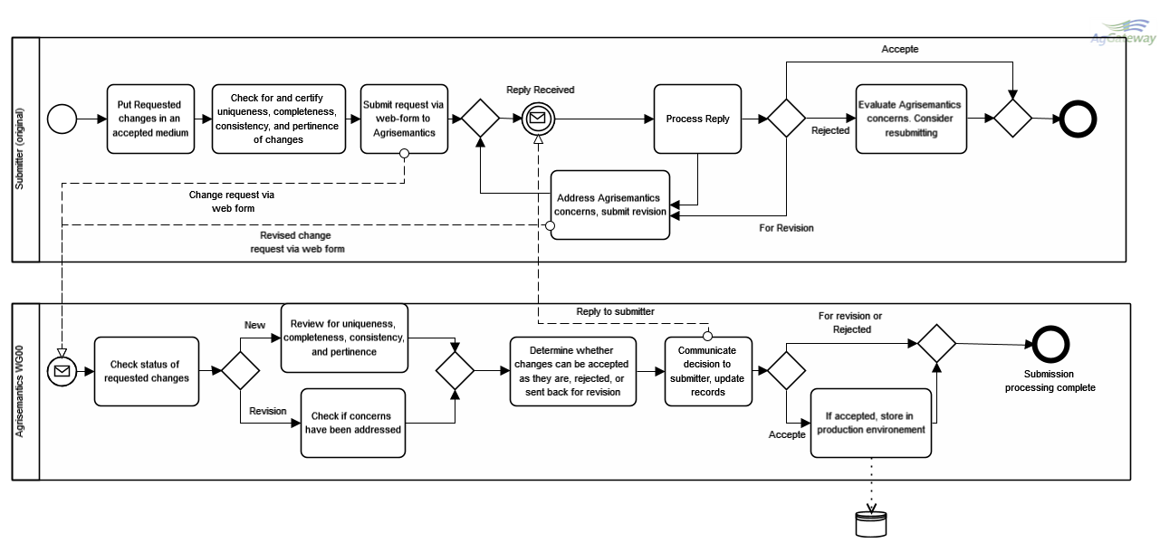
Change Request Process

Slide 30
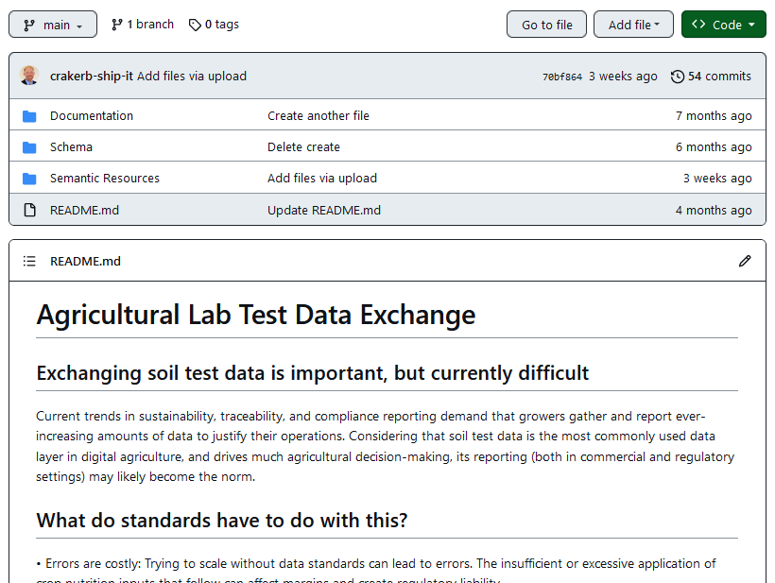
Resources Moving to GitHub
https://github.com/AgGateway/Modus
v2.0 Soil methods list
v2.0 Schema
v2.0 Manure methods list
v2.0 Botanical methods list
v2.0 Water methods list
v2.0 Nematode methods list
v2.0 Microbiology methods list
v2.0 Feed methods list
v2.0 Compost methods list
Complete
In Process
Started
Started

Slide 31
Precision Agriculture Irrigation Language (PAIL)
ASABE/ANSI S632-1, S632-3
ISO7673-1, 7673-2, 7673-3

Slide 32
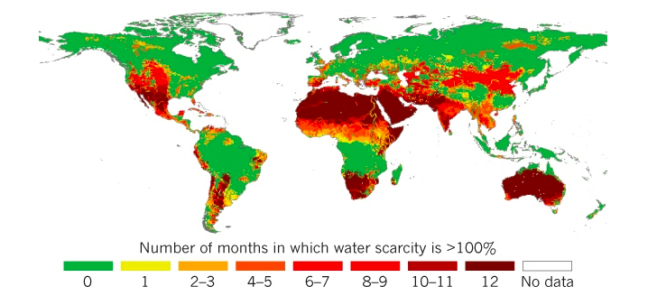
Water Scarcity Impacts 4 Billion People
Agriculture accounts for 70 percent of the freshwater
taken out of rivers, lakes, and aquifers.

Slide 33

Methods used in deciding when to irrigate
SIS: Scientific Irrigation Scheduling
Non-SIS: perception-based methods

Slide 34


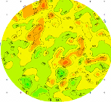
Integrated Decision Support Solution
INPUTS
Iterative Feedback Loop
OUTPUTS
On-Farm information
DYNAMIC
Weather
Optimal Irrigation management
Telemetry
Moisture sensors
Pumping +
distribution system
Uniform Fields
Decision support
static Data
Soil maps
Yield maps
VRI Fields
Online advisory system
Crop type, ET, weather integration, irrigation scheduling, etc.
FIXED
data output
Reports, trends, analysis, etc.
Risk management
Notes:
Review our concept of an integrated system
With an integrated decision support solution in place, all the tools and technologies “talk” to each other and offer growers the opportunity to rely on the data, not the consultants or people in the fields, to choose the right prescription for their fields. This allows growers to reduce their energy consumption or extend it further, improve yield and improve profitability. The problem is a lack of interoperability: the many pieces of this system have been unable to talk to each other.

Slide 35
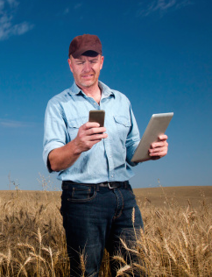
The Problem: A Lack of Interoperability
Equipment from different sensor OEMs produce data in different formats, with different data encoding conventions, vocabularies, units of measure, etc.
“Pieces of irrigation equipment don’t talk with one another”.
The problem worsens if they are running a mixed fleet of equipment.
Advisors spend valuable extra time
trying to analyze data and interpret it to help growers be more productive.
Hypothesis: Standardizing data inputs and outputs can solve this problem.
Notes:
Dan:

Slide 36
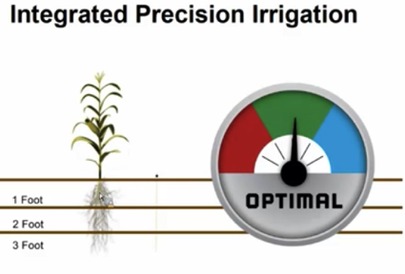
AgGateway’s PAIL: Goal & Objective
Goal: promote sustainable irrigation practices by facilitating integration of disparate data sources and management systems
Objective: provide an industry-wide format that will enable the exchange and use of data from irrigation management systems.
Notes:
The purpose of the PAIL project is to provide an industry-wide format that will enable the exchange and use of data from irrigation management systems. The data are currently stored in a variety of proprietary formats; the PAIL project seeks to develop a common language that can enable integration of these disparate sources of water management information.

Slide 37
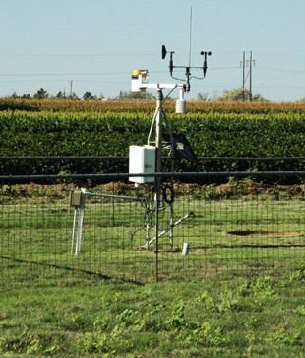
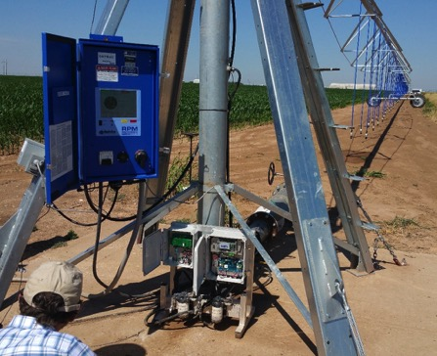
Scope
Observations
Operations

Slide 38
Part 1: Core Concepts
The group agreed on a level of abstraction that is closer to the business processes than to the hardware.
Supports Grower-Farm-Field-Cropzone
  Cropzone is a specific, well-defined concept, mappable to an ISO11783 PFD.
Standardized way of expressing space and time
  Includes radial and cartesian/polygon representations of space.
  Timescopes are analogous to ASP / TIM elements of 11783-10.
Standardizing codes for units of measure, but enables different sources.
ContextItem: capturing geopolitical-context-dependent data
Compatibility with AgGateway’s ADAPT

Slide 39
Field Operations Interoperability
Modern growers need to keep increasingly detailed and timely records of field operations (planting, irrigation, spraying, fertilization, harvest, etc.)
Motivations:
  Keeping their business profitable
  Regulatory pressure, and
  Supply-chain interest in traceability and sustainability.
Growers and their partners use multiple "documents" to exchange field operations information as part of their business processes.
Lack of common formats and shared meanings are huge problems
  The effort necessary to make the simplest of comparisons or exchanges with partners makes the documentation burden not scalable or sustainable by the grower.

Slide 40
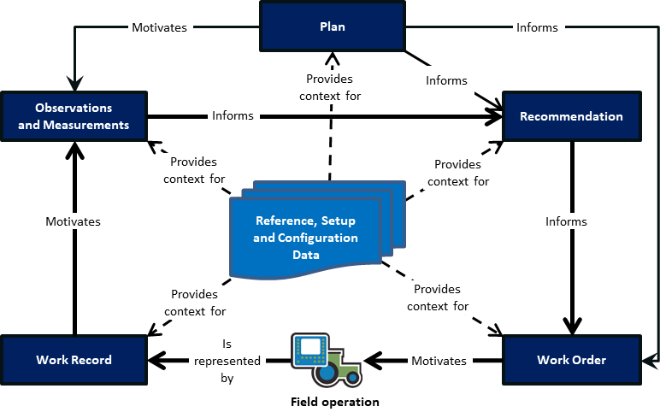
Core Documents and their Relationships

Slide 41
Part 2: Observations
Observations (e.g., scouting, soil water content, instrument data) have richer semantics than the DDI-mediated system of 11783-10.
ISO 19156 provides an abstract model that can represent the different aspects and rich semantics of an observation.
Part 2 is a realization of ISO 19156
in agriculture, meant to comply
with the abstract test suite
presented in 19156.
It seeks to represent data as
key-value pairs, with a
machine-readable set of definitions
behind the scenes.
Right-sized, application-specific level of detail.

Slide 42
Observations and Measurements
Observations & Measurements (“OM”) provide critical raw material for principled decision-making in field operations.
There are multiple attributes of an observation or measurement that need to be kept track of in order to allow the value to mean the same to sender and receiver.

Slide 43
Observations are everywhere in ag
Irrigation
  Soil water measurements
  Weather and climate data
Crop Nutrition
  Manure lab tests
  Soil test data
Post-Harvest
  Grain quality certificates
  Weight certificates (and scale tickets)
Logistics
  Asset management (grain dryers, grain bins, scales)
Crop Protection
  Diseases, insects, phenology, etc.
Crop simulation and other data-intensive applications.

Slide 44
Observation Codes vs Code Components
In their simplest form, observations can be interpreted as key-value pairs, where the key is an “observation code” that represents the meaning of the observation (e.g., feature of interest, observed property, method of observation, etc.)
  Example: liquid precipitation in a rain gauge, with tipping-bucket events signaling (0.1 mm).
In practice, it is not always optimal to embed all the meaning into the code, it instead being preferable to encode other things separately
  Example: a depth below ground parameter for volumetric soil water content observations.

Slide 45
Code structure
Sequence of code components
  We can sequence code components and enforce place value.
Each component has some attributes:
  ComponentType i.e., type (aggregation, property, feature, etc.)
  Selector: Value of a controlled vocabulary associated with this ComponentType (e.g., “Average”, “Median”, “Air”, “Soil”).
  Value: Numeric (or other) value of a parameter (e.g., “15”)
  Value type: Is this a number? A date? A string?
  UoM: Unit of measure for a parameter

Slide 46
Central ideas
Boil things down to a key-value pair
  (e.g., [key]: [value]), or (“http://omcodes.org/def/AT2315m : 72.4”)
  where the key communicates the meaning of the observation.
  This is equivalent to defining a data type.
Develop semantic infrastructure (e.g., an API or data-type registry) that can dispense machine-readable descriptions of the data types, searchable by their codes.
  Like ISO 11783-11’s data dictionary, but with 2023 aspirations

Slide 47

Core Documents and their Relationships
Motivates
Plan
Informs
Part 2
(based on
ISO 19156)
Provides
context for
Informs
Observations
and Measurements
Recommendation
Informs
Provides
context for
Provides
context for
Reference, Setup
and Configuration
Data
Motivates
Informs
Provides
context for
Provides
context for
Work Record
Is
represented
by
Work Order
Motivates
Field operation
Part 3 (aligned with ISO 11783)

Slide 48
Part 3: Operations
Corner arm (opens/closes in motion)
Non-irrigation field operations have an international standard (ISO 11783-10) for machine-to-FMIS communication; it does not fit irrigation well.
Also, ISO 11783’s assumption of a common electrical / communications infrastructure (e.g., ISOBUS) is not valid in the irrigation segment.
This led to the need for an irrigation-specific operations data model and serialization format that can naturally fit the different geometry and organization of irrigation systems.
This approach enables different levels of abstraction, ranging from specifying an irrigation amount on a field to a particular section of a specific machine.
End of primary, possible endgun
Local center of rotation (“bender”, primary before this point remains stationary during motion)
Pivot
center

Slide 49
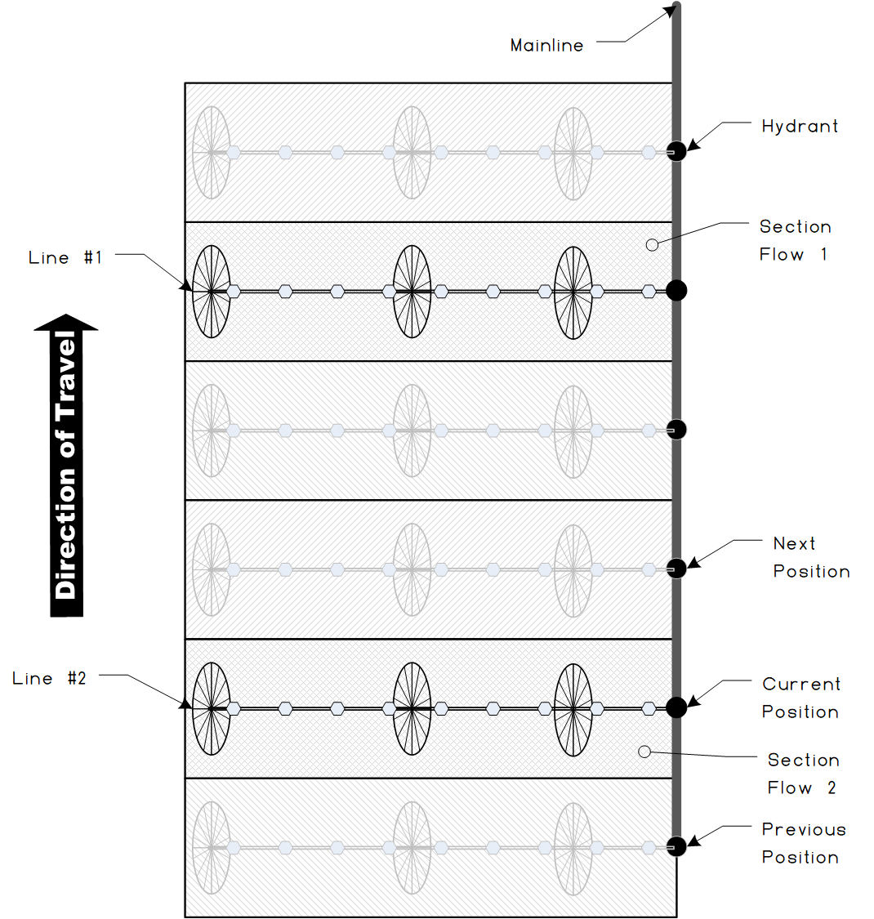
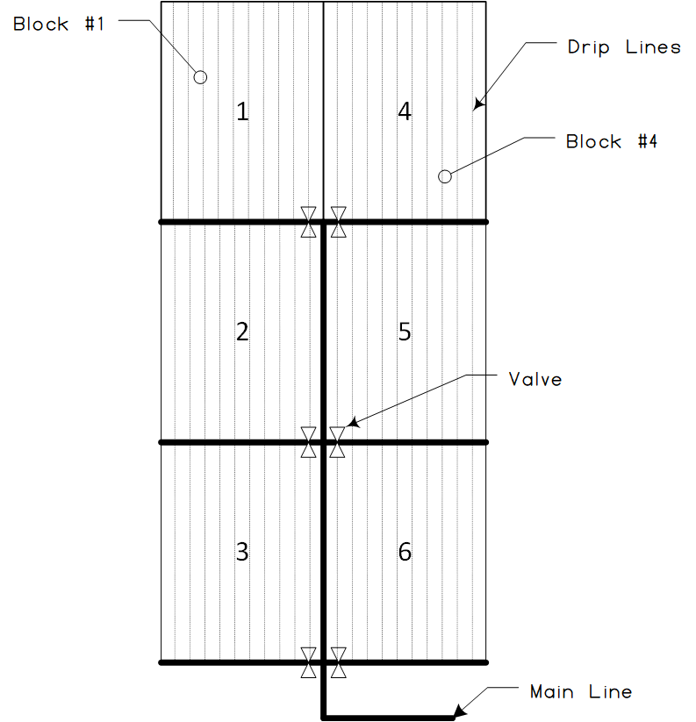
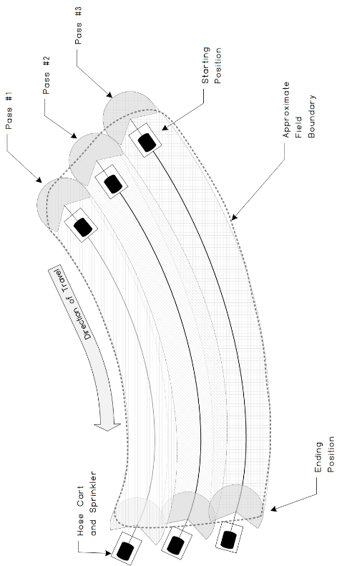
Irrigation System Examples
Drip
Wheel Line
Traveler

Slide 50
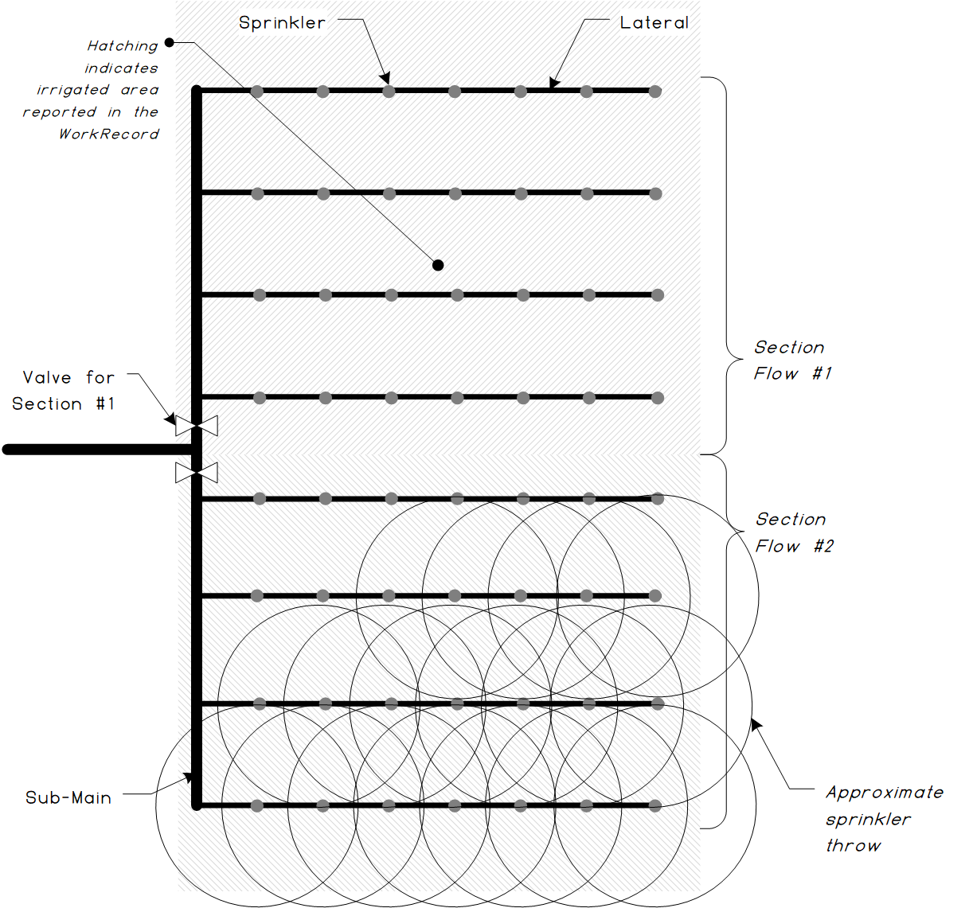
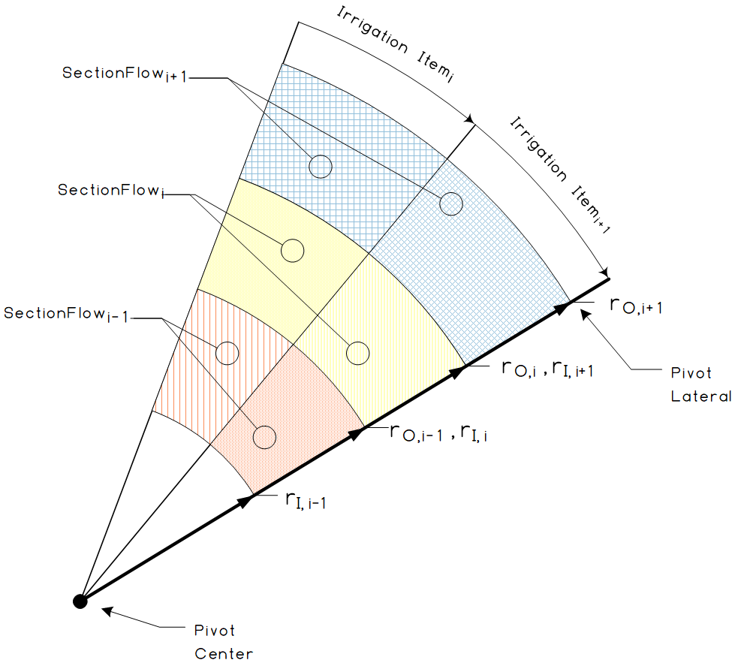
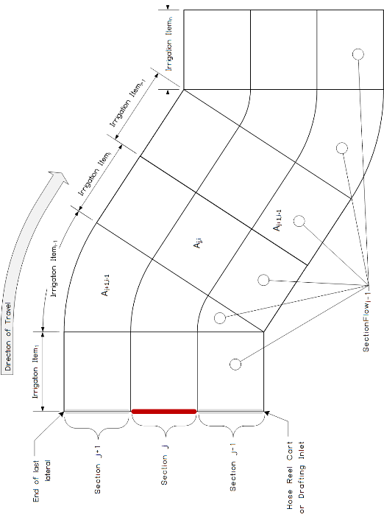
Irrigation System Examples
Solid Set
Linear Move
Pivot Sections

Slide 51
Field Boundaries

Slide 52
Field Boundary Working Groups
Purpose
  An unambiguous, core definition of a field and field boundary that can serve as the basis for different business use cases, can reduce effort and confusion across the value chain
  Preserving the meaning of that core definition, while adding relative meaning for different use cases
  Enable farmers to share their field data without having to learn a multitude of terms and meanings
  Assist in traceability efforts

Slide 53
Use Cases Documented
Field Boundary Use Case: Soil testing
Field Boundary Use Case: In-season imagery (remote sensing)
Field Boundary Use Case: Field operation by farmer
Field Boundary Use Case: Custom field operation by 3rd party
Field Boundary Use Case: Field attributes
Field Boundary Use Case: Autonomous Ground based vehicle operation
Field Boundary Use Case: Aerial vehicle operation
Field Boundary Use Case: Insurance reporting
Field Boundary Use Case: Reporting
Field Boundary Use Case: Crop insurance claim
Field Boundary Use Case: Sustainability/carbon reporting
Field Boundary Use Case: Traceability
Field Boundary Use Case: Multi-cropping: splitting/merging “fields” at different times
Field Boundary Use Case: Multi-cropping - Cover Crops
Field Boundary Use Case: Plat maps, county, PLSS, and other legal property lines

Slide 54
Definitions
Field
Field Boundary
A named and farmer-accepted physical space where production agriculture takes place used to partition and identify data.
A geometry that identifies the geo-spatial coordinates of a field. The boundary can be used to define the area for a particular operation, a particular crop or crops, or for legal purposes. A field can have different boundaries that may vary in geometry based on their specific use but are always either a polygon or multi-polygon.
AgGlossary.org

Slide 55
Field Boundary Categories
Conceptual Field Boundary
This boundary represents how the grower thinks of a field, and what they would share with service providers to allocate information at the highest level of the field concept within their operation.
Operational Boundary
This boundary represents a management area used for a specific set of field operations as defined by or for the grower and is shared with service providers for field operation execution, analysis, or recommendations.
Economic Defined Boundary
This boundary is used to define, plan, and analyze a field for business purposes as defined by or for the grower. Use examples would include greenhouse gas/sustainability/traceability programs, ownership/splits, and billing
Administrative Received Boundary
This boundary is used to organize data that is defined by some other authority and is generally not easy to change. Use examples include government programs, insurance, and legal land description.

Slide 56
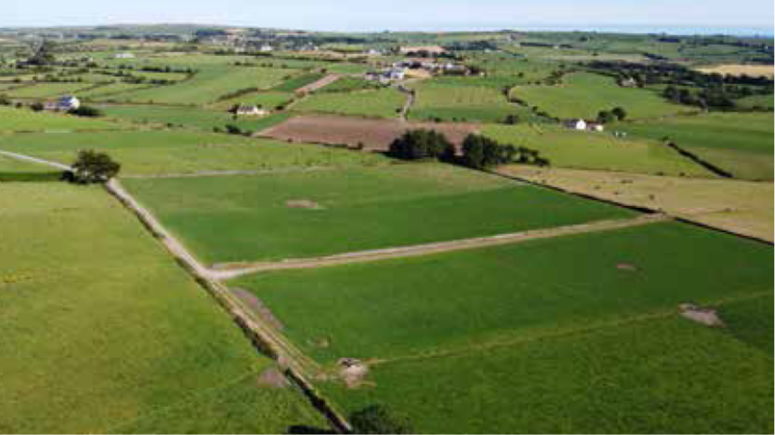
Field Boundary Working Groups
Series of Working Groups
  Use Cases, Terms & Definitions
  GNSS Accuracy
  Boundary Accuracy?
  Buffer zone creation/sharing?
  Boundary/Field Identifier?
  Format?
  …

Slide 57
Other Planned/Potential Future WG’s
Weather and forecast data standardized API
  Standardized interface for sharing weather and forecast data
Settlement sheet
  Building off Scale Ticket effort to define a standardized digital settlement sheet
Dairy Feed and Ration Use Case Documentation
  Document use cases, data requirements, processes related to data exchange for dairy feed
Agrisemantics: Common controlled vocabularies
  Find/create common controlled vocabularies identified common between multiple WG’s
Agrisemantics: Budgeting & infrastructure
  Evaluations of costs/benefits of various semantic resource management tool implementations
Data Ethics, Permissioning and Stewardship
  Update the data privacy whitepaper with the latest views pertaining to data access permissioning and stewardship
ASN (Advanced Ship Notice): Farmer to elevator/processor
  Standardized message for an advanced ship notice from a farm to elevator/processor
Scale head to ERP interface
  Standardized interface between scale heads and ERP systems
ShippedItemInstance gap check for crop protection, crop nutrition
  Review ShippedItemInstance for support of crop nutrition and/or crop protection products

Slide 58
Questions

