Slide 1
National Agricultural Producers Data Cooperative (NAPDC)
Introduction and Objectives

Slide 2
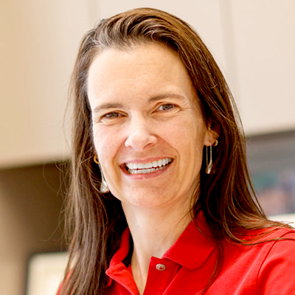
Introduction to NAPDC
Jennifer Clarke
Director, Quantitative Life Sciences Initiative Director, PhD in Complex Biosystems Professor of Statistics, Food Science and Technology University of Nebraska-Lincoln

Slide 3
Thank you for attending
Please put questions in the zoom chat window
Please keep yourself muted until the Q&A session
We will record this presentation and make recording available on the webpage
NADPC webpage: https://www.agdatacoop.org/

Slide 4
Motivation
data-driven agricultural production systems: producers need access to data, simulations, forecasts, and predictions to optimize their operations and enhance productivity
producer-driven: control over sharing and storing their own data
timeline: Fall 2021 – Spring 2023
USDA NIFA 2021-77039-35992

Slide 5
National Agricultural Producers Data Cooperative: Designing a Strategic Framework for Increasing Production and Driving Innovation
Overall objective: Develop a blueprint for a national data framework and cooperative
where producers, universities and not-for-profit entities can store and
share data and develop powerful tools that enable producers to
maximize their production and profitability
Sub-objectives:
Identifying needs and opportunities as well as challenges in physical infrastructure, human resources, and critical use cases
Engage and support diverse participation including all types of agricultural research institutions, producers, and representatives of relevant data producer and end-user organizations
Communicate and disseminate findings of all activities

Slide 6
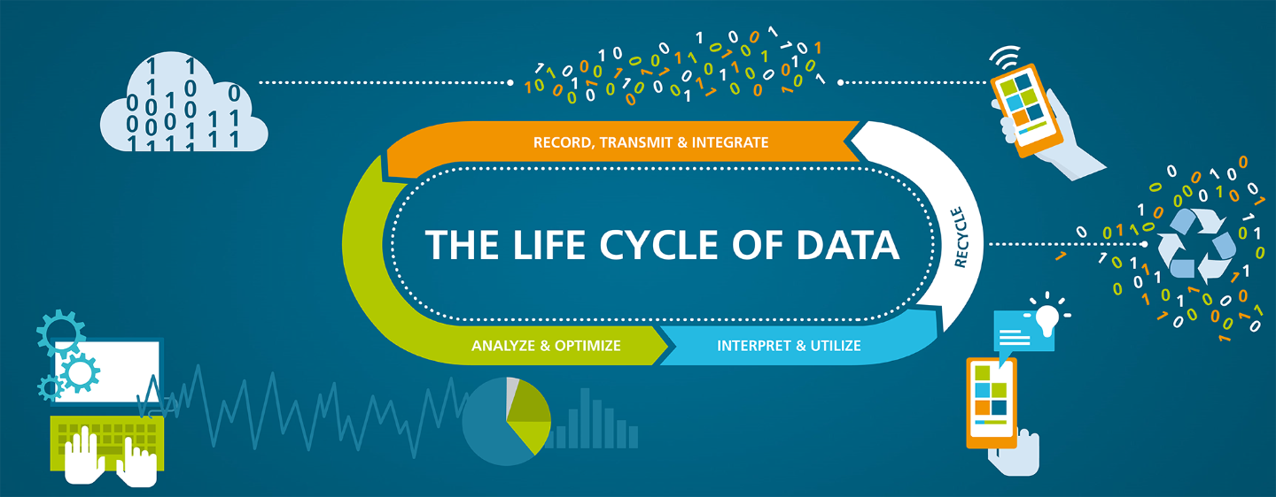
National Ag Producer Data Coop

Slide 7
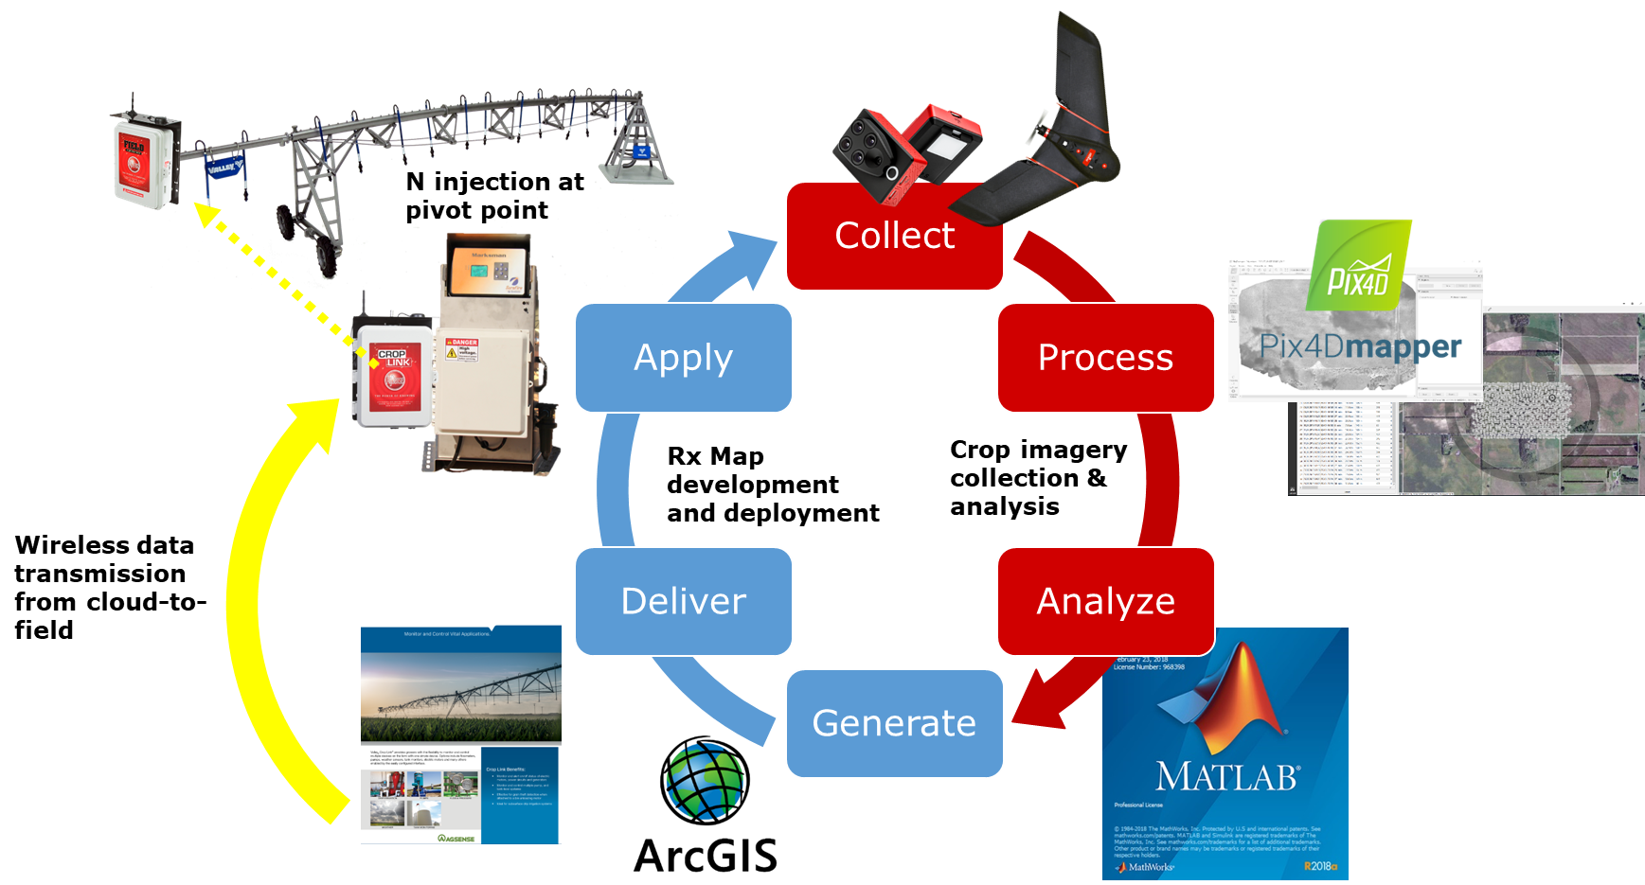
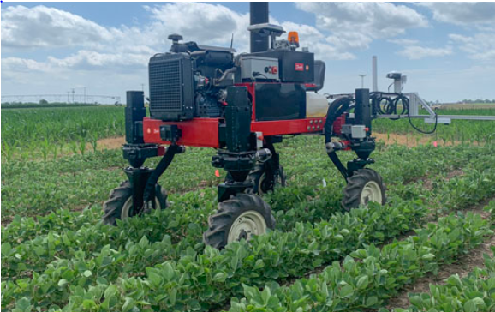
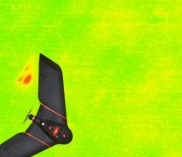
Why land grant universities? …
Automated Decision Making and Delivery
AI and Machine Learning
Field applications
Plant treatment
Application logging
As an example, we have automated the decision support for nitrogen application via center pivots
Land grant universities serve as regional and national knowledge repositories, innovators, and conveners
Partnerships among many entities will be key to transitioning data to innovation to practice
Robotic
Applications
Data processing
Interpretation
AI analysis
Recommendations
Automated Field Activities
Application logging
Remote Sensing
Wireless Data Transfer
IoT
Digital Agriculture
Automated Field Data Collection

Slide 8
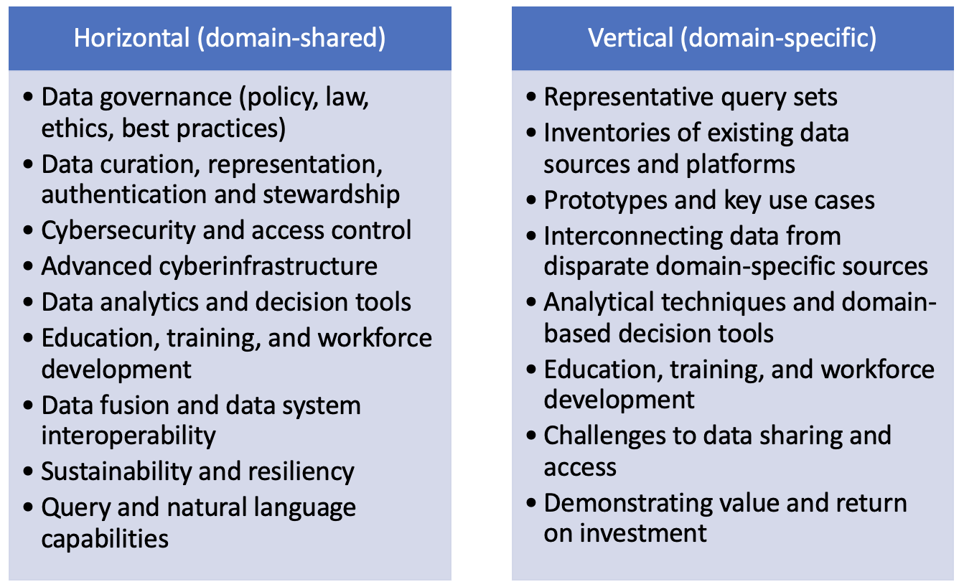
National Ag Producer Data Coop

Slide 9
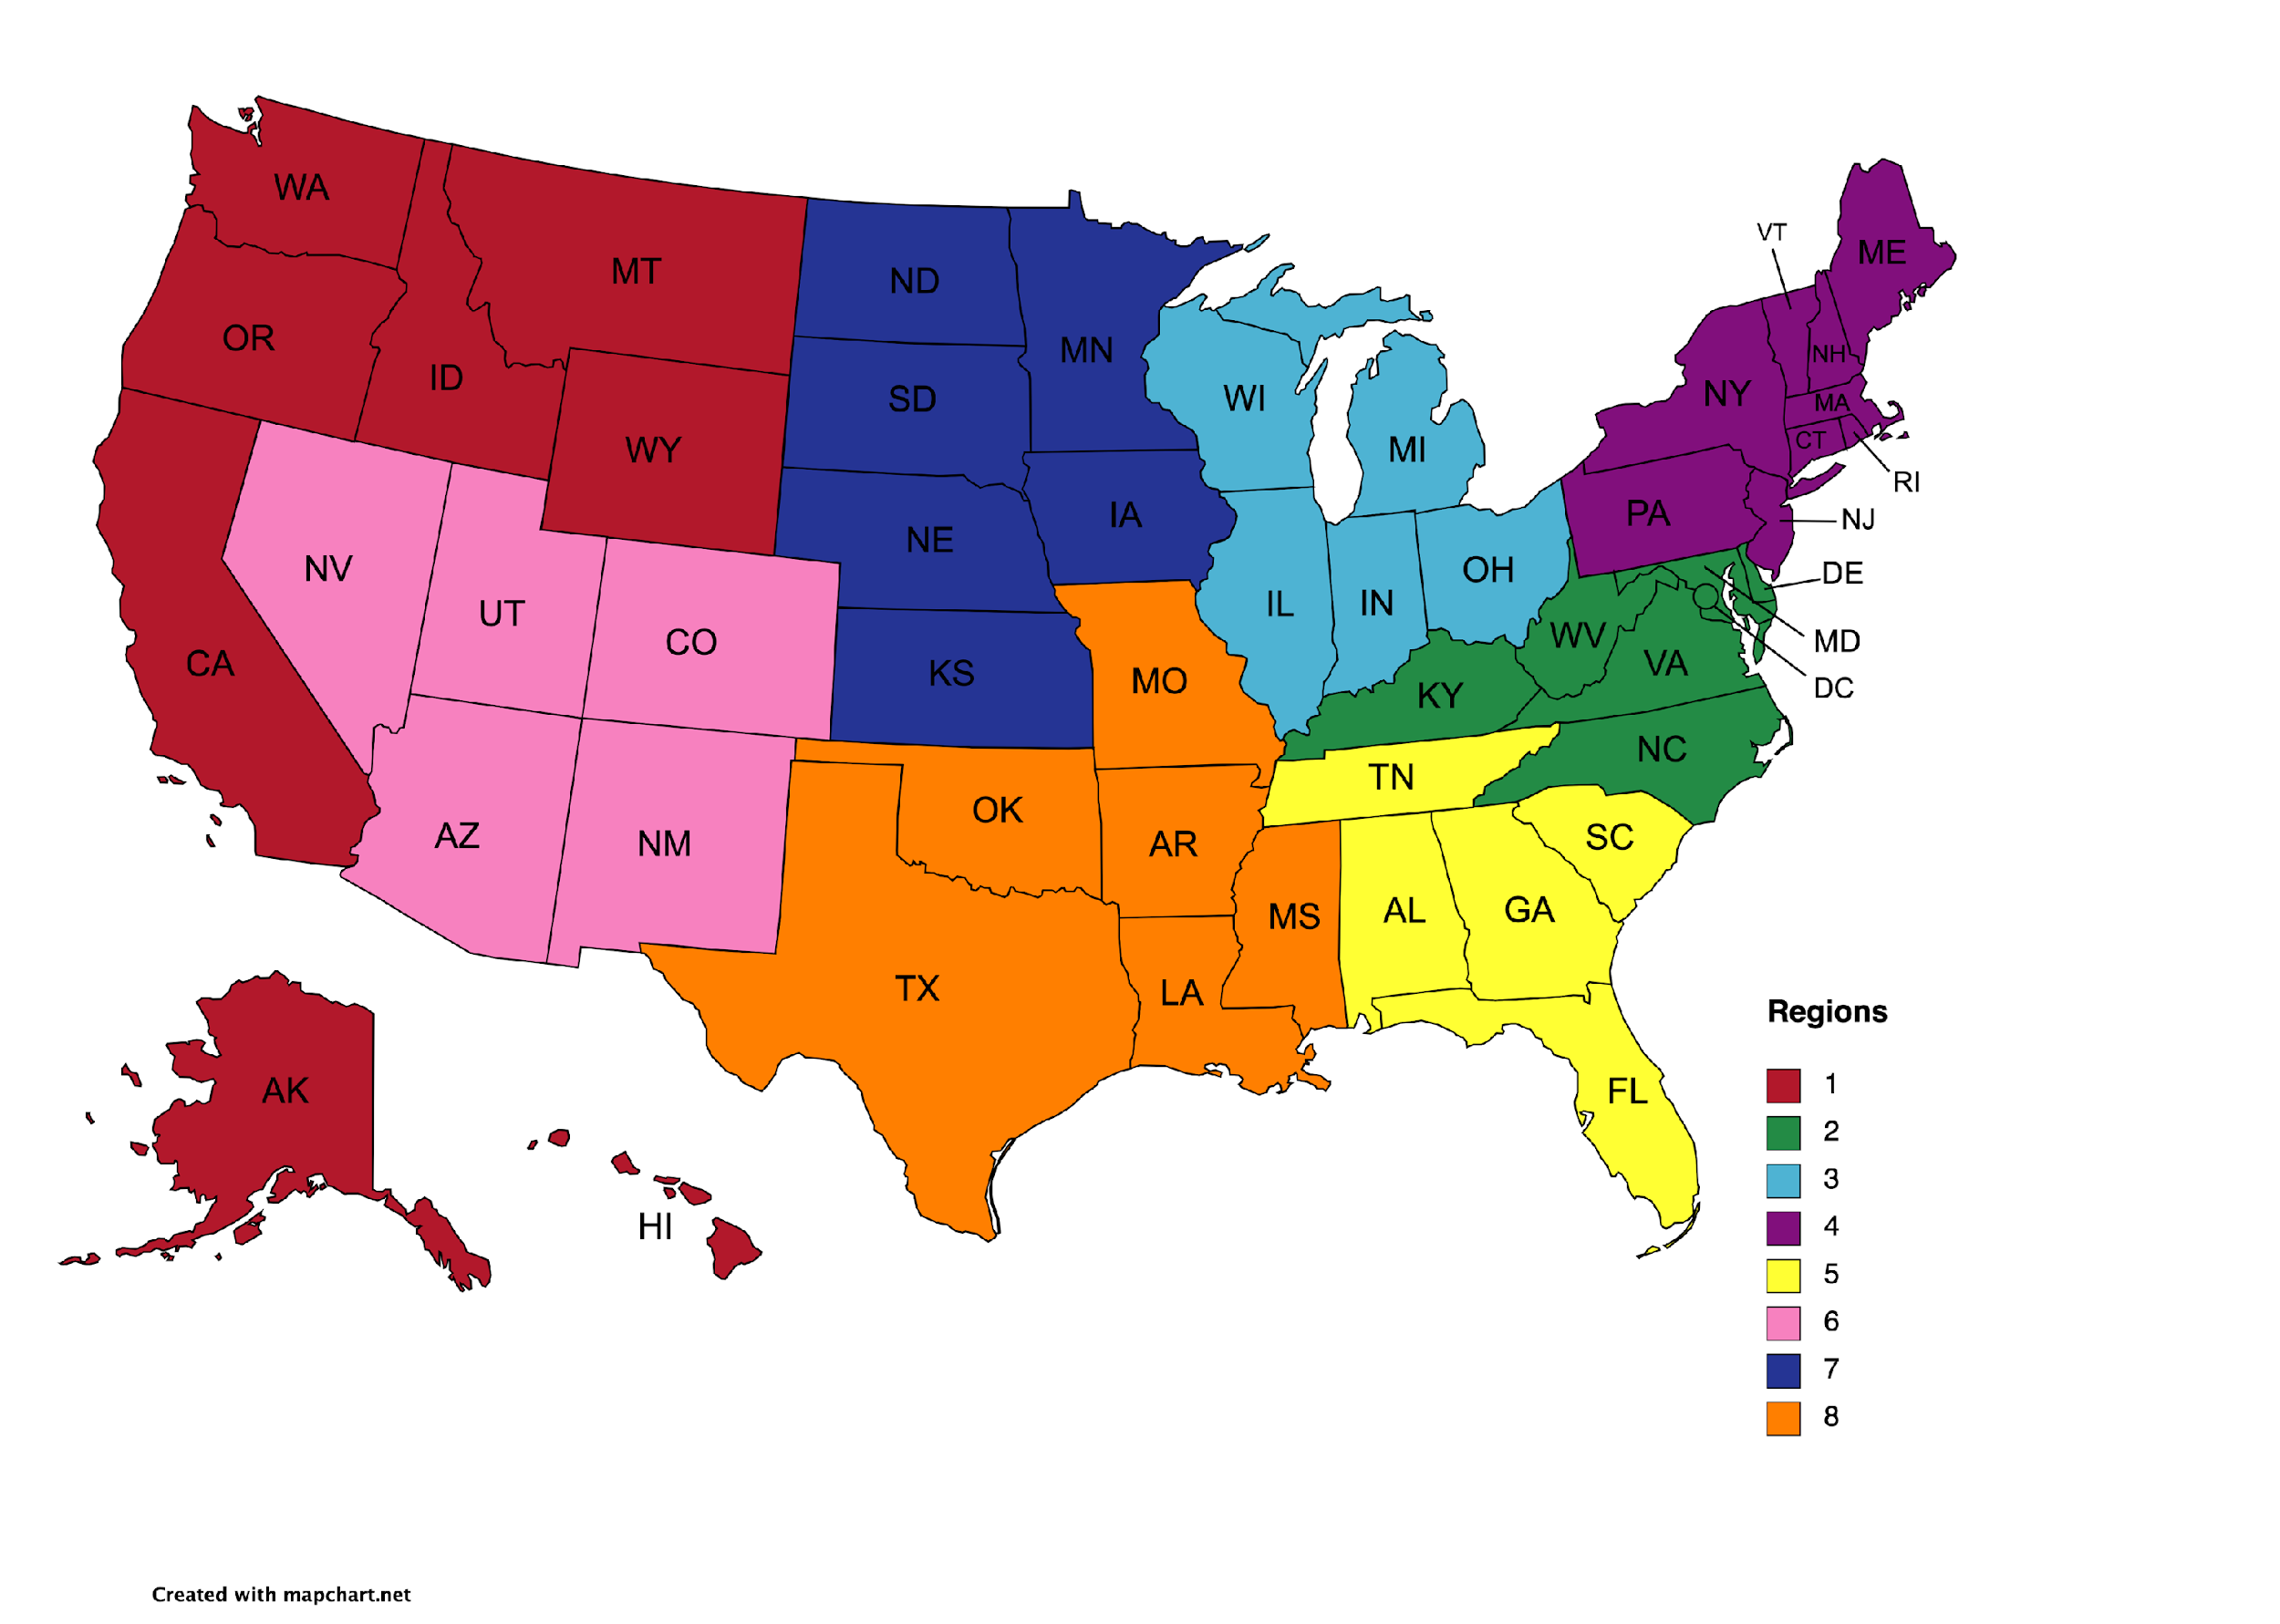
National Ag Producer Data Coop

Slide 10
Activities
monthly webinars on topics and ongoing projects relevant to framework development
convening grant mechanism to provide support for meetings and discussions among regional and national groups towards framework development
inaugural annual meeting of stakeholders and grant awardees to discuss and share findings, framework needs and challenges, publications, and key pilot projects for subsequent USDA funding

Slide 11
NAPDC website www.agdatacoop.org

Slide 12
Webinars
Elizabeth Lorang
Associate Professor of Libraries University of Nebraska-Lincoln
Trenton Franz
Associate Professor School of Natural Resources
University of Nebraska-Lincoln

Slide 13
Webinars
Monthly; topics and ongoing projects relevant to framework development
This monthly series will expose the NAPDC community to various topics and activities relevant to agricultural data systems and provide them with a platform for discussion. The focus will be on key components of the framework, both horizontal and vertical. To build the knowledge-base and technical strengths of NAPDC stakeholders, we will provide educational materials related to each webinar/discussion through the project website to facilitate asynchronous learning. This will enable individuals from all backgrounds to understand aspects of a data framework, build a common vocabulary, appreciate regional data challenges, develop technical expertise, and engage in best practices.
90 minutes or less
Deliverables for project: recorded sessions, attendee feedback, contributions to published work, documentation and training materials.
Recipients of planning grants may do a webinar as part of their efforts, but are not required to do so
Notes:
Trenton

Slide 14
Webinars
Two goals for every webinar:
1. is informing/educational for attendees
2. provides input into NAPDC's efforts and the blueprint framework through an activity in the webinar
NAPDC team has created a guide and template to assist with planning, ease logistical burden for presenters, and create some consistency among webinars
https://go.unl.edu/napdc-template (note that this is still a draft)
Guide/template asks presenters to frame:
a big question of relevance to NAPDC that they will take up
an objective for attendees (what attendees will learn)
an outcome for NAPDC (input into NAPDC's work)
an activity that leads to the outcome (with "activity" being intentionally broad)
Notes:
Liz

Slide 15
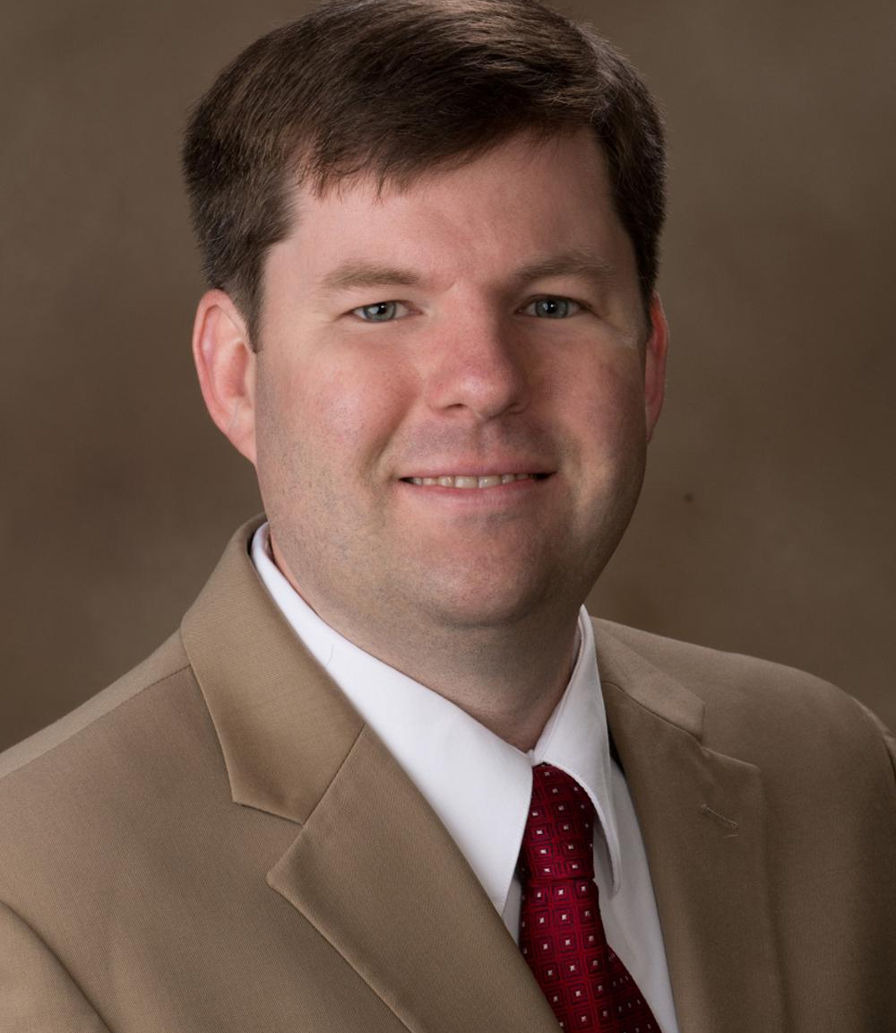
Convening Grants
Matthew Spangler
Professor of Animal Sciences University of Nebraska-Lincoln
Joe Luck
Associate Professor of Biological Systems Engineering Associate Director, ENREC
University of Nebraska-Lincoln

Slide 16
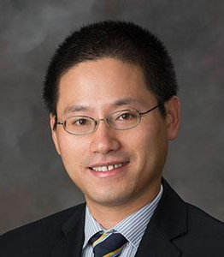
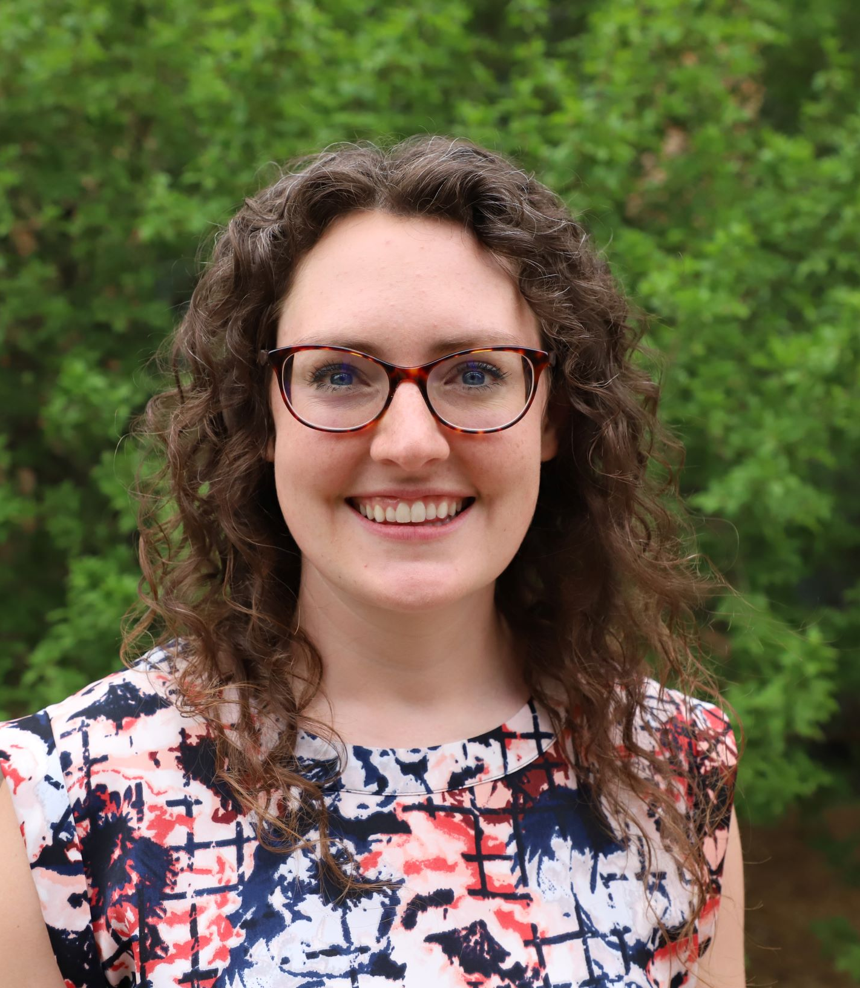
Inaugural Annual Meeting
Hongfeng Yu
Professor, School of Computing Director, Holland Computing Center
University of Nebraska-Lincoln
Laura Thompson
Associate Professor of Agricultural Extension University of Nebraska-Lincoln

Slide 17
Convening Grants
Matthew Spangler
Associate Professor of Animal Sciences University of Nebraska-Lincoln
Joe Luck
Professor of Biological Systems Engineering Associate Director, ENREC
University of Nebraska-Lincoln

Slide 18
Inaugural Annual Meeting
Hongfeng Yu
Associate Professor, School of Computing Director, Holland Computing Center
University of Nebraska-Lincoln
Laura Thompson
Associate Professor of Agricultural Extension University of Nebraska-Lincoln

Slide 19
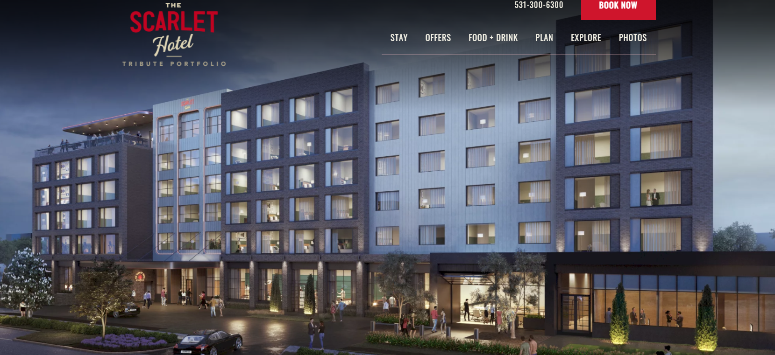
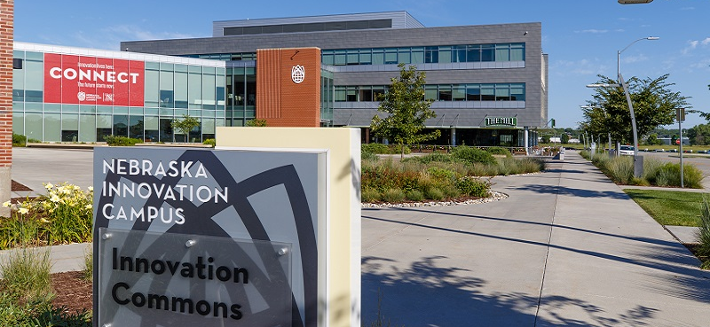
Inaugural Annual Meeting

Slide 20
Interested in being a participating organization?
https://www.agdatacoop.org/contact-us

Slide 21
Questions and Discussion

Slide 22
Thank you for attending!
https://www.agdatacoop.org/contact-us

Slide 23
National Agricultural Producers Data Cooperative (NAPDC)

